Slide 1
Gate Level Minimization
Chapter 3c
Imran Siddiqi
imran.siddiqi@mcs.edu.pk
Computer Science Department
College of Telecommunication Engineering
National University of Sciences and Technology

Slide 2
Degenerate & Non-Degenerate Forms
Consider 4 types of gates: AND, OR, NAND and NOR
There are 16 different configurations of 2-level implementation.
8 are said to be degenerate forms because they degenerate to a single operation.
8 are non-degenerate forms because they produce an implementation in sum of products or product of sums

Slide 3
Degenerate Forms
Reduce to a single operation
  AND-AND ==> AND
  AND-NAND ==> NAND
  OR-OR ==> OR
  OR-NOR ==> NOR
  NAND-OR ==> AND-NAND ==> NAND
  NAND-NOR ==> AND-AND ==> AND
  NOR-AND ==> OR-NOR ==> NOR
  NOR-NAND ==> OR-OR ==> OR

Slide 4
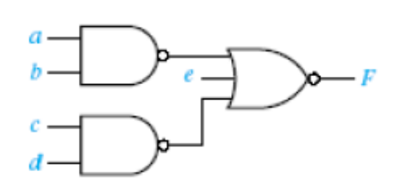
Degenerate Froms
Example – NAND-NOR
F=((ab)’+(cd)’+e)’
F=abcde’

Slide 5
Non-Degenerate Forms
AND-OR ✓ | OR-AND ✓
NAND-NAND ✓ | NOR-NOR ✓
NOR-OR | NAND-AND
OR-NAND | AND-NOR

Slide 6
Non-Degenerate Forms
Sum of Products
Product of Sums
AND-OR ✓ | OR-AND ✓
NAND-NAND ✓ | NOR-NOR ✓
NOR-OR | NAND-AND
OR-NAND | AND-NOR

Slide 7
Non-Degenerate Forms
AND-OR ✓ | OR-AND ✓
NAND-NAND ✓ | NOR-NOR ✓
NOR-OR | NAND-AND
OR-NAND | AND-NOR
OR-AND-INVERT
AND-OR-INVERT

Slide 8
AND-OR-INVERT
AND-NOR
NAND-AND
AND-NOR
AND-NOR
NAND-AND

Slide 9
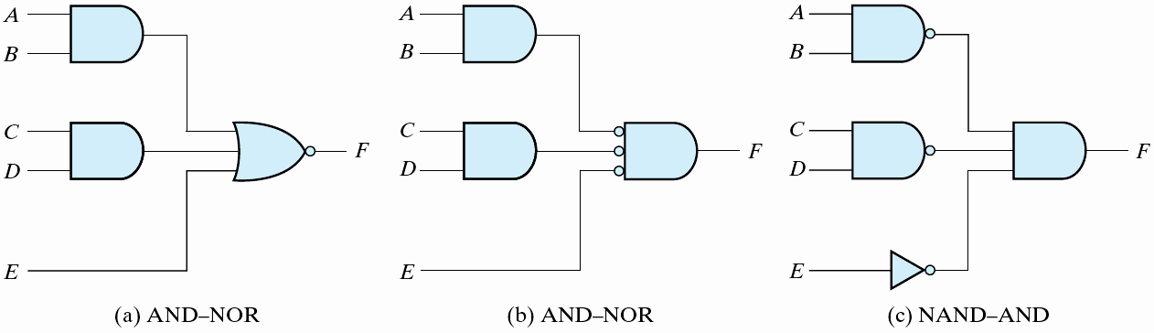
AND-OR-INVERT
F = (AB +CD +E)′

Slide 10
OR-AND-INVERT
OR-NAND
NOR-OR
OR-NAND
OR-NAND
NOR-OR

Slide 11
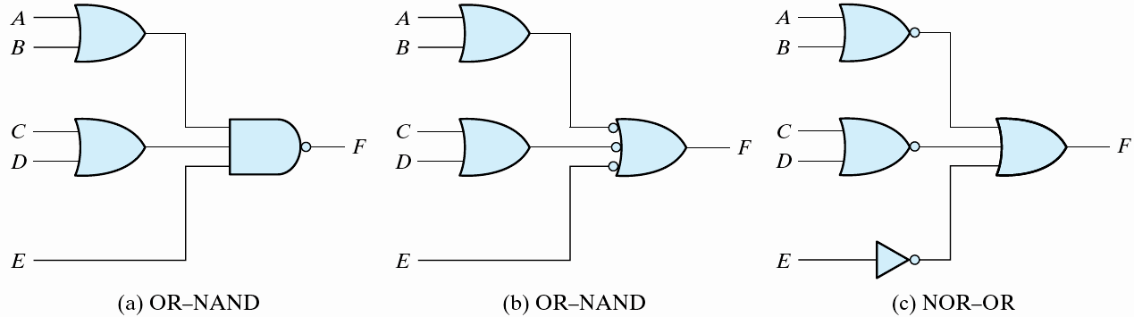
OR-AND-INVERT
  F = ((A+B)(C+D)E)'

Slide 12
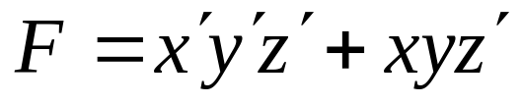
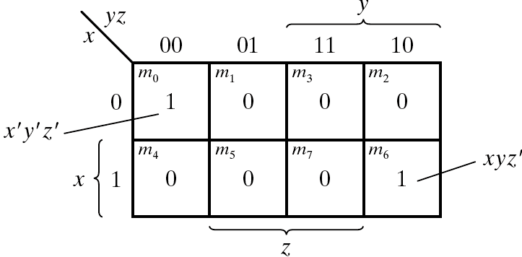
Example
Implement with AOI & OAI

Slide 13
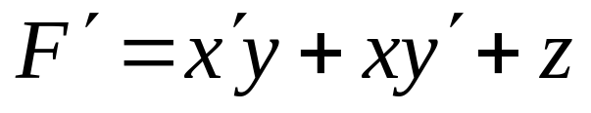
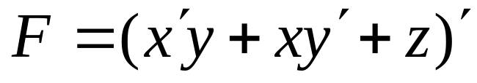
Example
For AOI
  Simplify into Sum of Products by combining 0s

Slide 14
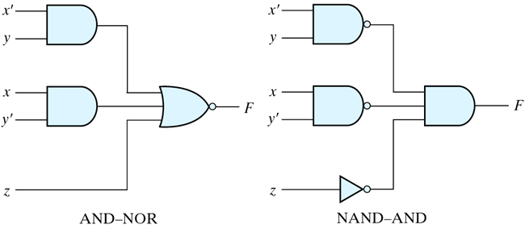
Example
For AOI
  Simplify into Sum of Products by combining 0s

Slide 15

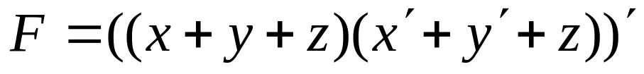
Example
For OAI
  Combine 1s in the map
  Take its complement to get Product of Sums
  Get the function F by complementing the above

Slide 16
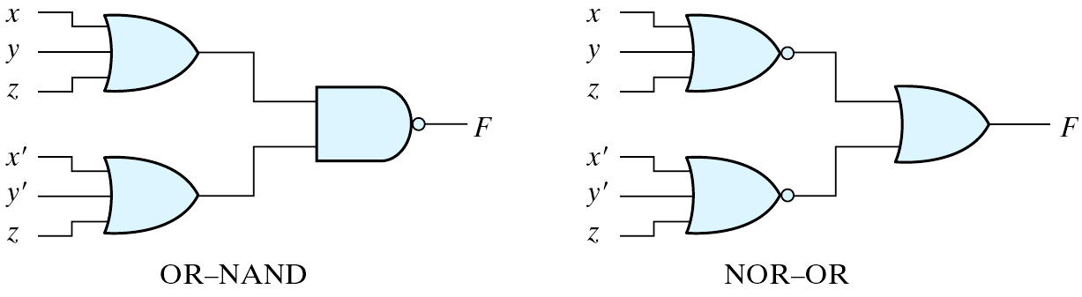
Example
OAI

Slide 17

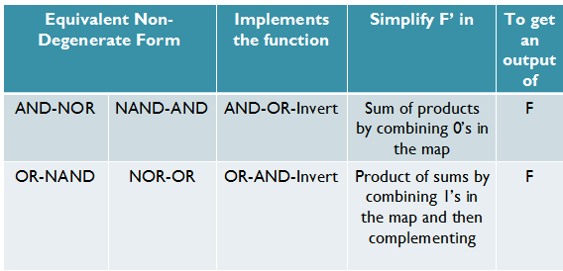
AOI & OAI - Rules

Slide 18
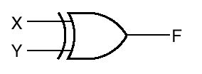


Exclusive-OR Function
Exclusive-OR (XOR) performs the following function
  x ⊕ y = xy’ + x’y
This function is equal to one only if either x or y is equal to one but not both

Slide 19
Exclusive-OR Functions
Exclusive NOR (XNOR) can be generated by taking the complement of an XOR operation
  (x ⊕ y)’ = xy + x’y’
The following identities apply to XOR
  x ⊕ 0 = x
  x ⊕ 1 = x’
  x ⊕ x = 0
  x ⊕ x’ = 1
XOR is also commutative and associative

Slide 20
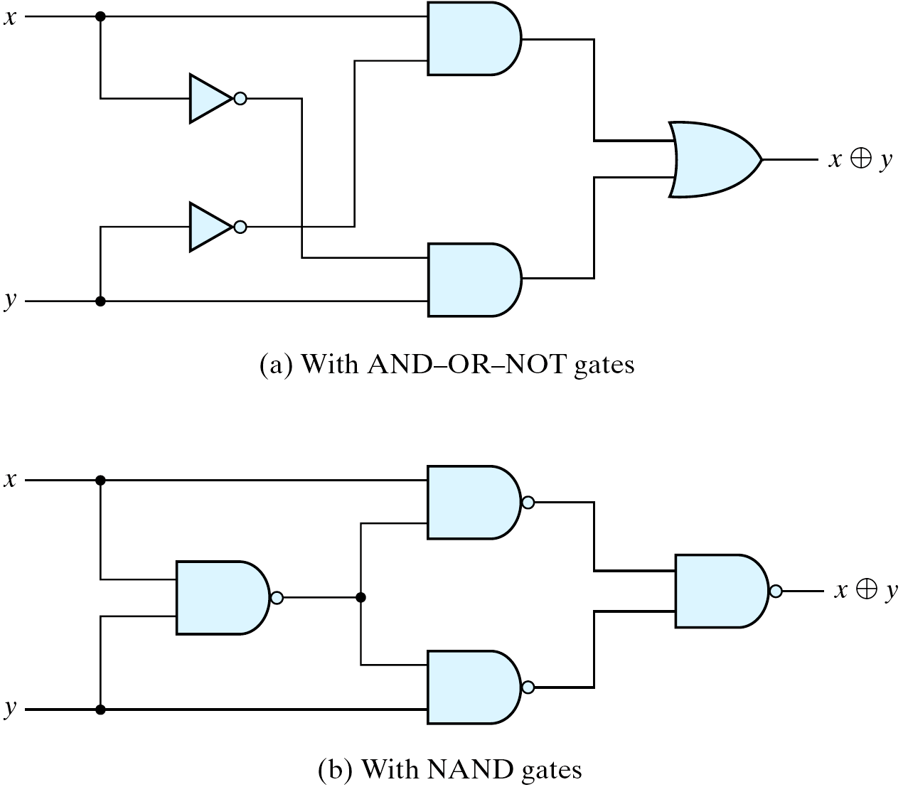
XOR Implementations

Slide 21
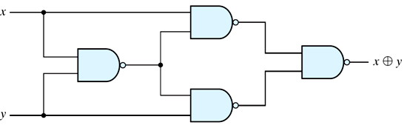
XOR Implementations
(x.(xy)’)’
((x.(xy)’)’ . (y.(xy)’)’)’
(xy)’
(y.(xy)’)’
F=((x.(xy)’)’ . (y.(xy)’)’)’
F= x.(xy)’ + y.(xy)’
F= x.(x’+y’) + y.(x’+y’)
F= x.x’+x.y’ + x’.y+y.y’
F=xy’+x’y

Slide 22
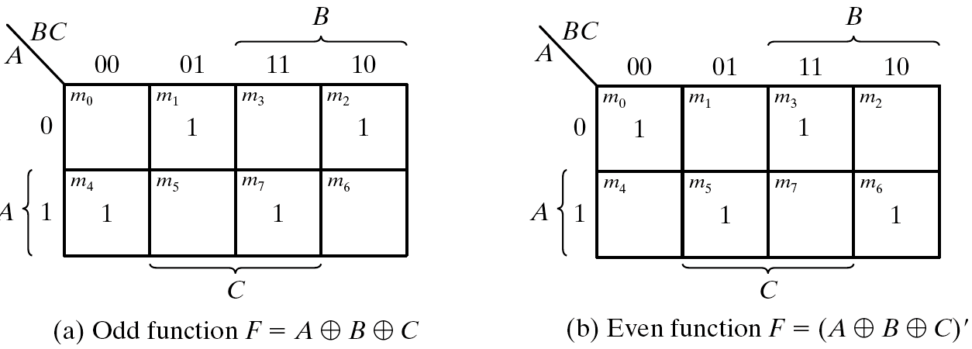
Odd Function
A⊕B⊕C = (AB'+A'B)C' +(AB+A'B')C = AB'C'+A'BC'+ABC+A'B'C = Σ(1, 2, 4, 7)
XOR is a odd function → an odd number of 1's, then F = 1.
XNOR is a even function → an even number of 1's, then F = 1.

Slide 23
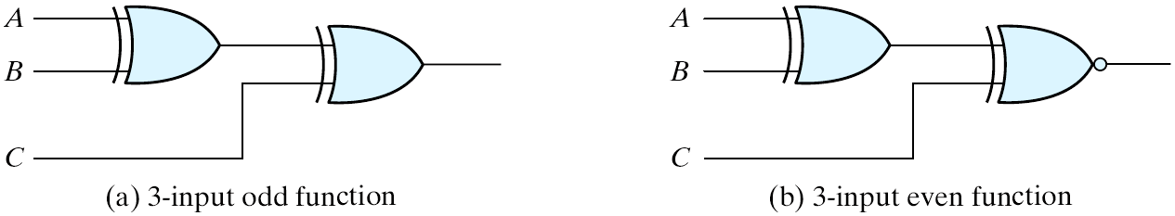
XOR & XNOR
Logic diagrams of odd and even functions
Logic Diagrams of Odd and Even Functions

Slide 24
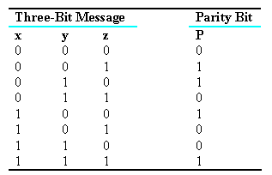
Parity Generation & Checking
XOR functions are very useful in systems requiring error-detection and correction codes.
  A circuit that generates a parity bit is called a parity generator.
  The circuit that checks the parity is called a parity checker.
Even Parity

Slide 25
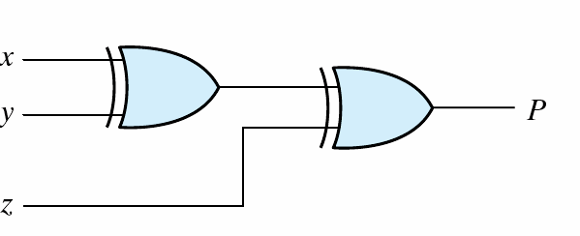
Parity Generator
  A parity bit: P = x⊕y⊕z
X
Y
Z
P
3-bit even parity generator

Slide 26
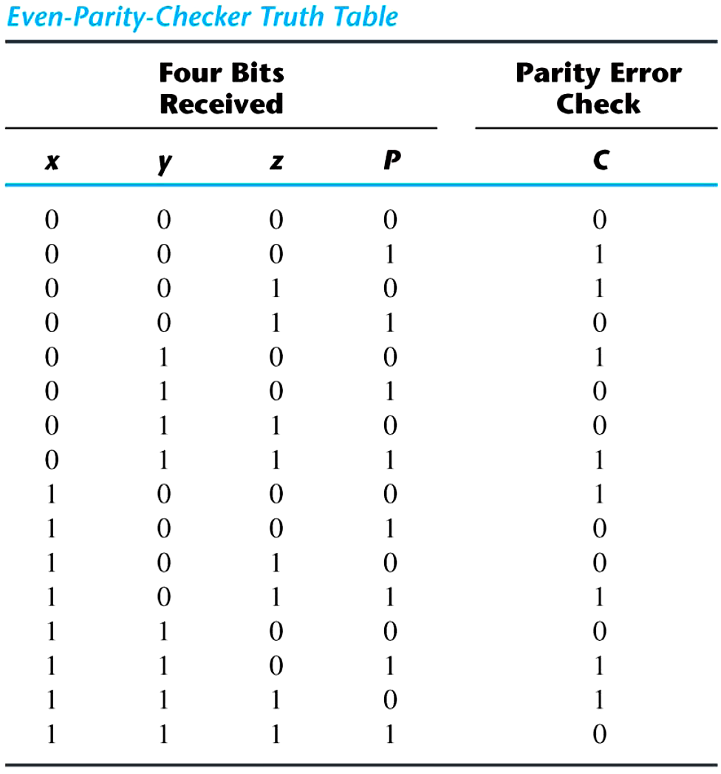
Parity Checker
Parity check:
  C = x⊕y⊕z⊕P
  C=1: one bit error or an odd number of data bit error
  C=0: correct or an even # of data bit error

Slide 27
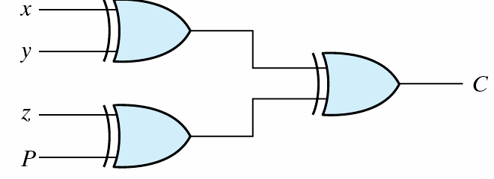
Parity Checker
Parity check: C = x⊕y⊕z⊕P
  C=1: one bit error or an odd number of data bit error
  C=0: correct or an even # of data bit error
Parity checker

Slide 28
References
Chapter 3 – Digital Design Morris Mano
Material in these slides has been taken from, the following resources

